Slide 1

DiaVio: LLM-Empowered Diagnosis of Safety Violations in ADS Simulation Testing
You Lu, Yifan Tian, Yuyang Bi, Bihuan Chen, Xin Peng
Fudan University, Shanghai, China
luy22@m.fudan.edu.cn
Notes:
hello, everyone. Im You Lu from fudan university, shanghai, china. Today, im going to introduce our latest work: large language model empowered diagnosis of safety violations in simulation testing for autonomous driving system.
My original report was a little long, so I just deleted some of the pages of the slides but I still hope that I can explain what we did clearly. OK, as we all konw, in recent decades, autonomous driving systems have developped a lot.

Slide 2
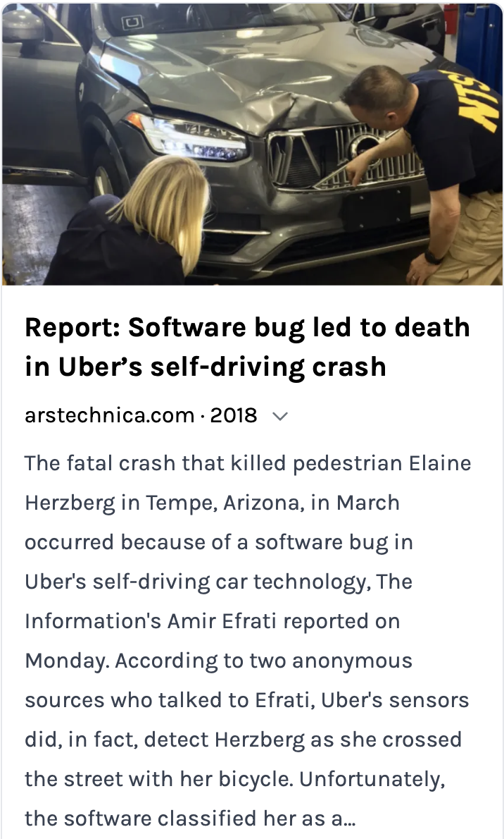
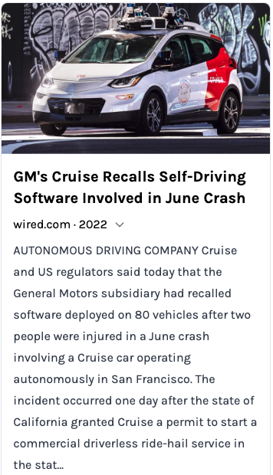
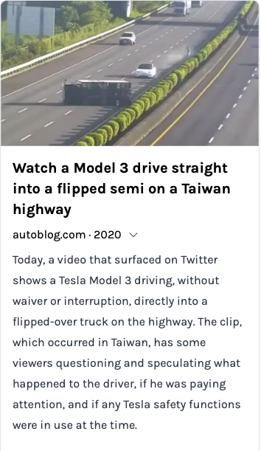
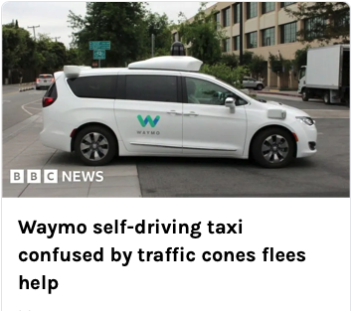
Why Simulation Testing is Needed?
Statistical question | How many miles (years) would autonomous vehicles have to be driven... | (A) 1.09 fatalities per 100 million miles? | (B) 77 reported injuries per 100 million miles? | (C) 190 reported crashes per 100 million miles?
 | (1) without failure to demonstrate with 95% confidence that their failure rate is at most... | 275 million miles (12.5 years) | 3.9 million miles (2 months) | 1.6 million miles (1 month)
 | (2) to demonstrate with 95% confidence their failure rate to within 20% of the true rate of... | 8.8 billion miles (400 years) | 125 million miles (5.7 years) | 51 million miles (2.3 years)
 | (3) to demonstrate with 95% confidence and 80% power that their failure rate is 20% better than the human driver failure rate of... | 11 billion miles (500 years) | 161 million miles (7.3 years) | 65 million miles (3 years)
On-road testing is expensive and impossible to test corner cases or dangerous situations.
N. Kalra and S. M. Paddock, “Driving to safety: How many miles of driving would it take to demonstrate autonomous vehicle reliability?” Transportation Research Part A: Policy and Practice, vol. 94, pp. 182-193, 2016.
Notes:
However, due to the extremely complex and diverse real-world driving environment, current autonomous driving systems still struggle woth conner cases, leading to serious consequences. Extensive testing is needed to ensure the safety and reliablity of ADS.
In order to prove that the ads is 20% safer than human drivers with a 95% confidence , it need to drive more than 11 billion miles
on-road testing is expensive and impossible to test corner cases or dangerous situations.

Slide 3
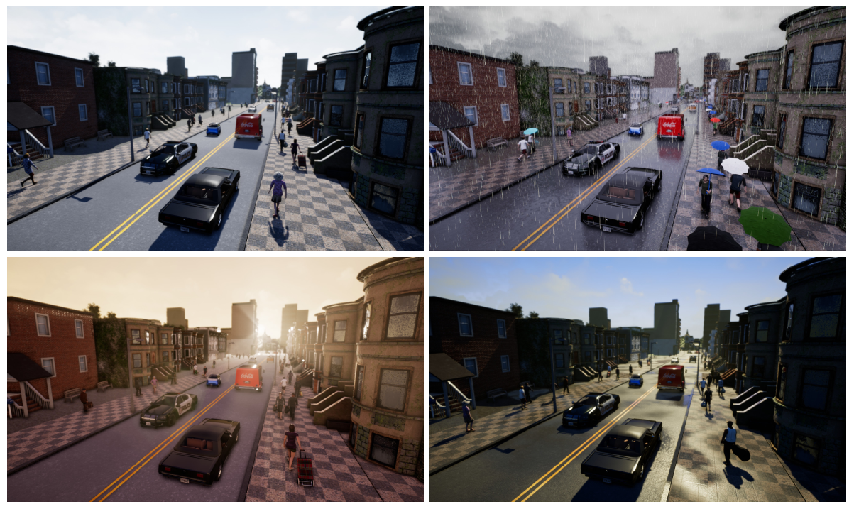

Problems in Scenario-based Testing
Test Case
Generation
Method
Graphical
Simulator
Layer1 Road Level
Layer2 Traffic Infrastructure
Layer3 Manipulation of L1 L2
Layer4 Object
Autonomous Driving System
Layer5 Weather
Does every violation scenario reveal bugs in the ADS?
DSL based method, e.g., OpenScenario
API based method, e.g., AV-Fuzzer
Scenario Layer Model
No!
The simulation is not realistic enough
Manual verification takes a long time
NPC Fault or EGO Fault?
Notes:
To this end, simulation testing has played an import role in ads testing. because it is convenient and cheap.
The academic community has proposed many scenario-based testing approacheds to generate diverse driving scenarios for ADS. These methods usually consist of three parts:
the ADS under test, the graphical simulator and the test case generation method.
Some of them use domain specific language to design and implement scenarios represented by OpenScenario, and other methods may use api provided by the simulator to automatically generate scenarios, such as AV-Fuzzer. Most of these methods follow the 5-layer scenario model.
And Both these method have been proved that they can find violation scenarios.
Now we got the problem, does every violation scenario found by these methods reveal a bug in the autonomous driving system?
The answer is NO!
We all know that the simulation is not realistic enough. For example, an NPC vehicle may not obey traffic rules and collide with the EGO vehicle aggresssively In this case, we believe that the collision was caused by the NPC vehicle. We have to diagnose violation scenarios but such manual verification may take a lot of time.

Slide 4
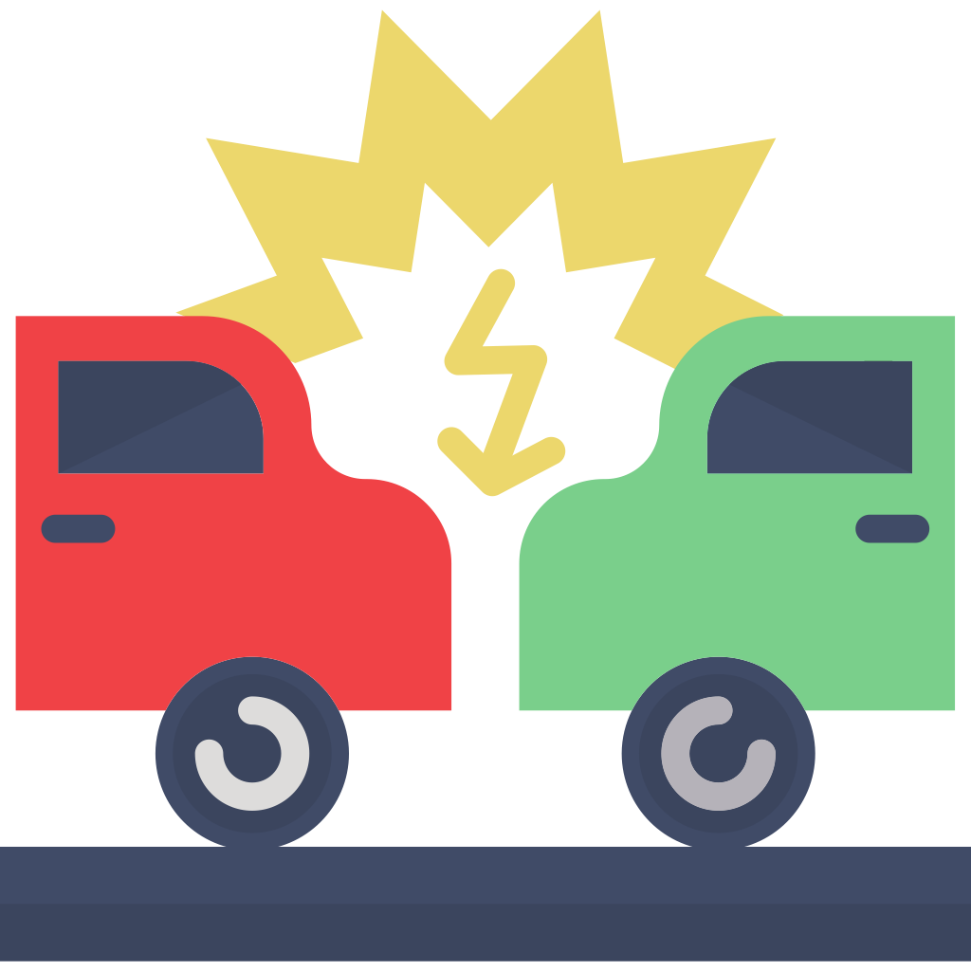

liability determination
Automatic Violation Diagnosis
Two Aspects of Violation Diagnosis
Liability Determination: determine whether the EGO or NPC vehicle bears the responsibility
Crash Classification: classify the crash into a specific category (e.g., backover collision)
How to automatically diagnose the violations?
Accident reports contain diagnosis knowledge
Leverage large language models
The Critical Precrash Event for Vehicle #2 was when this vehicle turned left across the path of Vehicle #1. Vehicle #1 failed to keep safe distance, causing a front-to-side collision.
liability determination
Accident Reports
How to align real-world accident reports described in natural language and violation scenarios in simulation testing?
Domain specific language
Leverage large language models
Notes:
An automatic diagnosis of violation scenarios is need in simualation testing.
In our work, we define the diagnosis of violation as two aspects: liability determination and carsh classfication.
But how to automatically diagnose the violations?
Actually, the real word accident reports usually contain diagnosis knowledge. We hope to use large language models to learn the diagnosis ability from accident reports, in which case, it can serve as a policeman in simulation testing.
The gap is How to align real-world accident reports described in natural language and violation scenarios in simulation testing?
We propose a domain specific language to describe the crash scenario and use LLM to convert the format of accident reports.

Slide 5


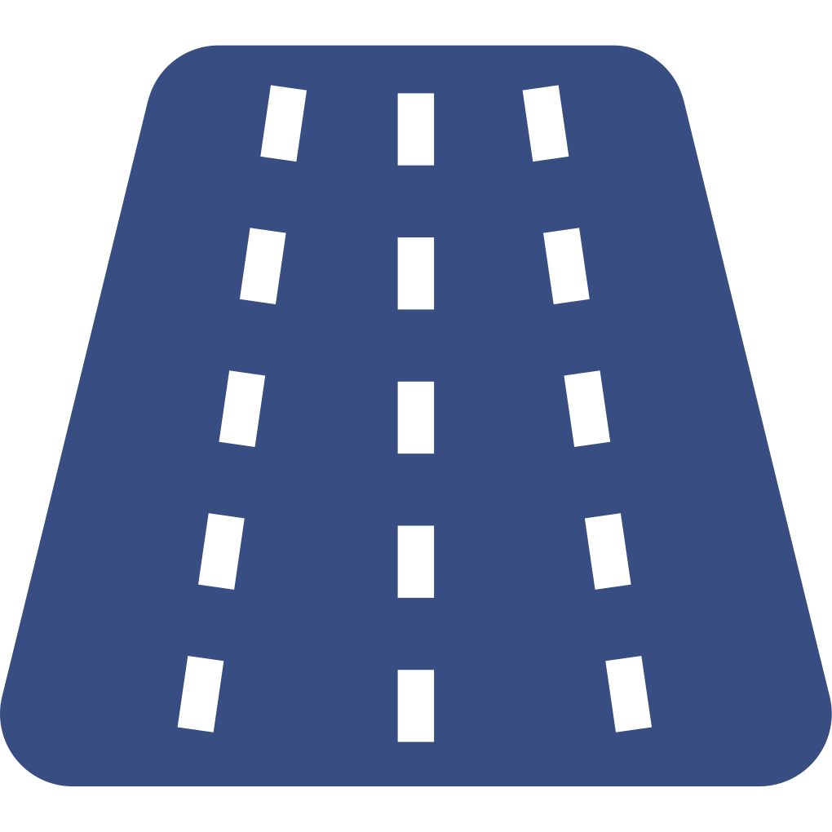


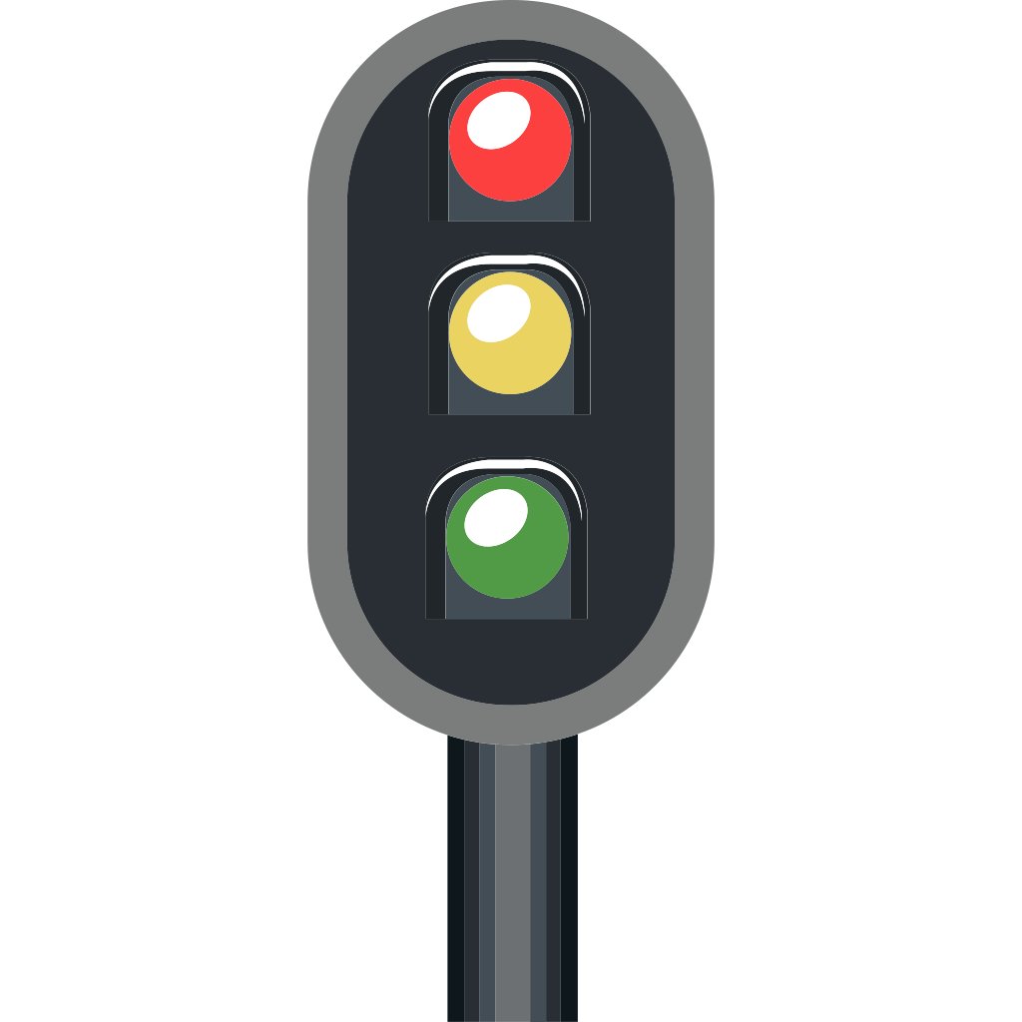






Domain Specific Language for Crash
A crash consists of five components, i.e., Road, Environment, Obstacles, Vehicles and Diagnosis. Each component is composed of subcomponents and atomic elements.
<Crash>
<Road>
<Environment>
<Obstacles>
<Obstacle>
<Vehicles>
<Vehicle>
<Behavior>
<Diagnosis>
::=
::=
::=
::=
::=
::=
::=
::=
::=
<Road>; <Environment>; <Obstacles>;
<Vehicles>; <Diagnosis>;
<RoadType>; <Lanes>; <RoadShape>; <RoadSlope>; <SpeedLimit>;
<Weather>; <RoadCondition>; <TrafficSignals>;
<Obstacle>; <Obstacles>;
<Type>; <Location>;
∅ | <Vehicle>; <Vehicles>;
<ImpactSide>; <MovingOnWhichWay>; <LocationAfterCrash>; <Behavior>;
<Direction>; <VehicleAction>; <TravelSpeed>; <WhetherToBrake>; <AttemptedLaneCrossing>; <IsAgainstRules>;
<ResponsibleParty>; <ReasonForLiability>;
<CrashCategory>; <ReasonForCategory>;
Responsible Party
Crash Category
Part of the Syntax of Crash DSL
Notes:
The DSL serves as an intermediate representation to align crashes in accident reports in natural language and crashes in violation scenarios in simulation testing.
We define semantic elements derived from real-world accident reports to describe crashes.
A crash consists of five components, i.e., Road, Environment, Obstacles, Vehicles and Diagnosis. Each component is composed of subcomponents and atomic elements.

Slide 6





Approach Overview of DiaVio
Parse 1
Dataset Preparation
LLM Fine-Tuning
Accident Report
from Real World
Crash Description
in DSL
Base LLM
Fine-Tuned LLM
DSL for Crash
Violation Scenario
in Simulation Testing
Crash Description
in DSL
Fine-Tuned LLM
Diagnostic Result
Crash Description Generation
LLM-Empowered Diagnosis
Parse 2
Notes:
Specifically, based on our domain specific language of carsh scenario, our approach consists of two phases.
First，in the model training phase, we convert real-world traffic accident reports into crash descriptions, and fine-tune the base LLM to learn diagnostic capabilities.
In the inference phase, we use the API provided by the simulator to automatically generate collision descriptions for each violation scenario identified in the simulation testing, and use our fine-tuned LLM for diagnosis.

Slide 7
Phase 1 - Dataset Preparation: Accident Report Collection
National Highway Traffic Safety Administration provides real-world accident report datasets
National Motor Vehicle Crash Causation Survey (NMVCCS) dataset
Crash Injury Research Engineering Network (CIREN) dataset
The crash occurred on a two lane undivided level roadway with a posted speed limit of 30 mph (48 kph) on a weekday evening. It was raining, the roadway was wet and it was dark, but lighted at the time of the crash. | Road and environmental information
Vehicle #1, a 1995 Ford Escort and Vehicle #2, a 2000 Chevrolet Express van, were traveling north on the roadway. Vehicle #2 was ahead of Vehicle #1. Vehicle #2 pulled to the right side of the roadway into a driveway entrance. Vehicle #2 then entered the roadway to the left and attempted to cross over into a driveway on the west side of the roadway. Vehicle #1 took evasive maneuvers by braking and steering left. Vehicle #1 struck Vehicle #2 in the left side with its front. Both vehicles came to rest on the roadway. Police Reported Travel Speed is Not reported for V1 and Not reported for V2. | Vehicle information
It was a front-to side crash. The Critical Precrash Event for Vehicle #1 was when Vehicle #2 entered the roadway from the driveway across Vehicle #1’s path. The Critical Reason for the Critical Event was not coded to this vehicle. It is possible that the driver of Vehicle #1 made a false assumption that Vehicle #2 would remain on the shoulder as he passed.The Critical Precrash Event for Vehicle #2 was when this vehicle turned left across the path of Vehicle #1. The Critical Reason for the Critical Event for this vehicle was an unknown type of driver error. It is possible that due to the darkness and weather conditions that the driver did not see or misjudged the approach of Vehicle #1. The passenger advised that driver was turning left into the deli parking lot. | Liability determination and crash classification and their causes
Notes:
We collected a large number of traffic accident reports from the National Highway Traffic Safety Administration, such as the National Motor Vehicle Crash Causation Survey dataset and the Crash Injury Research Engineering Network dataset
Here is an example of traffic accident report.
A traffic accident report usually contains three paragraphs. The first paragraph contains the information of road and environment, the second paragraph contains the information of vehicle behaviors, and the third paragraph contains the diagnosis such as Liability determination and crash classification and their causes.
We summarize our DSL from real-world accident reports. As illustrated by an accident report at this page, the first part contains information about road condition and environment of the crash, the second part includes information about the vehicles’ behaviors, and the third part contains the police's analysis of the accident. Our DSL is designed to encompass a broad range of components and subcomponents based on accident reports in NMVCCS and CIREN dataset. When preparing the ground truth for RQ5, we manually analyze the 369 accident reports, and our DSL can fully describe these accidents. Therefore, we believe our DSL is reasonable.

Slide 8
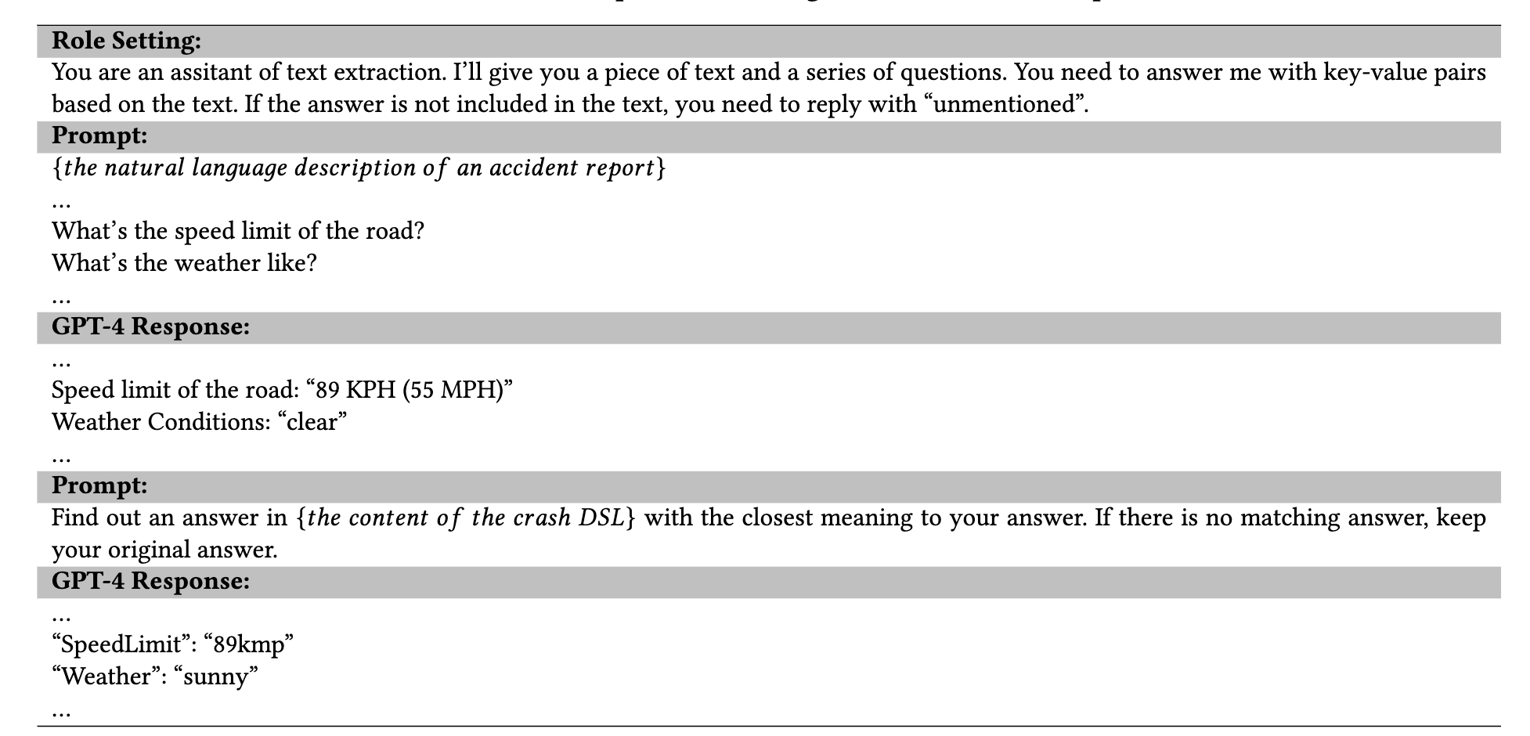
Phase 1 - Dataset Preparation: Data Format Conversion
Convert a traffic accident report described in natural language into structured information that conforms to our DSL syntax
GPT-4 prompt chaining: formulate a series of questions to interact with GPT-4, obtaining structured description of crashes in accident reports
Notes:
We use GPT4 which has strong capability in natural language understanding and text extraction, to convert a traffic accident report described in natural language into structured information that conforms to our DSL.
We use the prompt chaining method by defining a series of questions to interact with GPT4 to obtain results.
We use GPT-4 only for the task of information extraction because 1)this task is a one-time job that is only involved in data preparation for fine-tuning, and 2)the cost of using GPT-4 is thus controllable. We use open-source LLMs rather than GPT-4 for fine-tuning and violation diagnosis because 1)fine-tuning incurs high cost, and 2)diagnosis in real-world application scenario also incur a constant cost for each violation. Therefore, it is cost-effective and sustainable to choose open-source LLMs instead of closed-source GPT-4 for our customized fine-tuning task.

Slide 9

Phase 1 - Dataset Preparation: Data Format Conversion
The crash occurred on a two lane undivided level roadway with a posted speed limit of 30 mph (48 kph) on a weekday evening. It was raining, the roadway was wet and it was dark, but lighted at the time of the crash.
Vehicle #1, a 1995 Ford Escort and Vehicle #2, a 2000 Chevrolet Express van, were traveling north on the roadway. Vehicle #2 was ahead of Vehicle #1. Vehicle #2 pulled to the right side of the roadway into a driveway entrance. Vehicle #2 then entered the roadway to the left and attempted to cross over into a driveway on the west side of the roadway. Vehicle #1 took evasive maneuvers by braking and steering left. Vehicle #1 struck Vehicle #2 in the left side with its front. Both vehicles came to rest on the roadway. Police Reported Travel Speed is Not reported for V1 and Not reported for V2.
It was a front-to side crash. The Critical Precrash Event for Vehicle #1 was when Vehicle #2 entered the roadway from the driveway across Vehicle #1’s path. The Critical Reason for the Critical Event was not coded to this vehicle. It is possible that the driver of Vehicle #1 made a false assumption that Vehicle #2 would remain on the shoulder as he passed.The Critical Precrash Event for Vehicle #2 was when this vehicle turned left across the path of Vehicle #1. The Critical Reason for the Critical Event for this vehicle was an unknown type of driver error. It is possible that due to the darkness and weather conditions that the driver did not see or misjudged the approach of Vehicle #1. The passenger advised that driver was turning left into the deli parking lot.
"Road": {
"RoadType": "undivided driveway",
"LaneType": "two lane",
"RoadShape": "straight",
"RoadSlope": "level",
"SpeedLimit": 30
}
"Environment": {
"RoadCondition": "wet",
"Weather": "rainy",
"TrafficSignals": "unmentioned"
},
"Obstacles": {
"Type": "unmentioned",
"Location": "unmentioned"
},
"Vehicle1": {
"ImpactSide": "front",
"MovingOnWhichWay": "lane1",
"LocationAfterCrash": "rested on the roadway",
"Behavior": {
"WhetherToBrake": "yes",
"Direction": "north",
"VehicleAction": "going straight, steering left",
"TravelSpeed": "unmentioned",
"IsAgainstRules": "no",
"AttemptedAvoidanceManeuvers": "yes",
"AttemptedLaneCrossing": "no"
}
}
"Vehicle2": {
"ImpactSide": "left",
"MovingOnWhichWay": "lane1",
"LocationAfterCrash": "rested on the roadway",
"Behavior": {
"WhetherToBrake": "unmentioned",
"Direction": "north",
"VehicleAction": "turning left",
"TravelSpeed": "unmentioned",
"IsAgainstRules": "no",
"AttemptedAvoidanceManeuvers": "unmentioned",
"AttemptedLaneCrossing": "left-change"
}
}
"Diagnosis": {
"ResponsibleParty": "Vehicle2",
"ReasonForLiability": “Vehicle #2 entered the roadway from the driveway across Vehicle #1’s path.”
"CrashCategory": "front-to-side",
"ReasonForCategory": “Vehicle #1 struck Vehicle #2 in the left side with its front.”
}
Notes:
Here is an example of the conversion. We get the key information from accident report and fill them in the structure data conforms to our DSL.

Slide 10
Phase 1 - LLM Fine-Tuning
Fine-Tuning Dataset
instruction: set the model’s role as an assistant of two diagnosis tasks
input: include the Road, Environment, Obstacles and Vehicles components in the crash descriptions for accident reports
output: correspond to the Diagnosis components in the crash descriptions for accident reports
LoRA Configuration
lora_r: 16
lora_alpha: 32
learning rate: 3e⁻⁴
batch size: 128
epochs: 4
optimizer: AdamW
Notes:
Then, we construct the dataset for fine-tuning. Each piece of data in the dataset includes an instruction for setting the model role, the input that includes the road, environment, obstacle, and vehicle behavior information. Beside, We set the diagnosis result as the expected output.
Finally, we fine-tune the model using Lora.

Slide 11
Phase 2 - Crash Description Generation
Violation Detector
Road Parser
Rule Checker
Running Red Light Detection
Environment and Obstacle Parser
Hard Acceleration/ Braking Detection
Solid Lane Crossing Detection
Test Case
Generation
Method
Graphical
Simulator
Vehicle Analyzer
Over Speed Detection
Description Generator
…
Autonomous Driving System
Crash Description
Notes:
At the same time, we need to automatically obtain the description of the collision from the simulator.
We used the API of simulator to design and implement a tool for automatic generation of crash descriptions.
It contains 6 components in the red boxes.
We implement six key modules to generate crash description reports from simulations. These modules involve more than simply calling APIs from the simulator. First, we parse map files to obtain the relationships among various lanes, junctions and traffic signals within the map, which are not directly provided by the simulator. Second, we model vehicle behaviors and implement logical code to determine their behaviors based on their states. Finally, we integrate road structure and vehicle behaviors to check whether the vehicles involved in the crash are against certain rules.
Our Rule Checker module involves two types of rules. The first is traffic rules (i.e., running red light, solid lane crossing, and over speed). The second is potentially unsafe driving behaviors (i.e., hard acceleration/braking). While the direct relationship between such behaviors and violating traffic rules may not be obvious, they can indirectly reflect the safety and compliance of driving behaviors. Hard acceleration and hard braking are often considered indicators of aggressive driving, which increase the risk of traffic accidents.

Slide 12
Phase 2 - LLM-Empowered Diagnosis
Data Format
instruction: set the model’s role as an assistant of two diagnosis tasks
input: include the Road, Environment, Obstacles and Vehicles components in the generated violation reports
output: Diagnosis of violation
Model Configuration
maximum context tokens: 1024
max_new_tokens: 200
temperature: 0.5
Notes:
After obtaining the description of the collision senario the simulatior, we can use the fine-tuned large language model for diagnosis. In particular, we set the temperature of the model to 0.5 to balance the creativity and stability of the model.

Slide 13
Evualtion Setup
Research Questions
RQ1: How effective is DiaVio in liability determination on real-world accident reports?
RQ2: How effective is DiaVio in crash classification on real-world accident reports?
RQ3: How effective and efficient is DiaVio in diagnosing violation scenarios, compared with manual diagnosis?
RQ4: What are the types of violations DiaVio helps to find?
RQ5: What is the quality of accident report parsing and the consistency of our LLM-empowered violation diagnosis?
Notes:
We evaluate our tool from the following 5 aspects.
First, we evaluate our tool on real accident report in the two tasks. Then we evaluate the effectiveness and efficiency of our tool in diagnosing violation scenarios, compared with manual diagnosis.
We also mannually alalysize the types of violations found by our tool.
At last, we evaluate the quality of accident report parsing and the consistency of our LLM-empowered violation diagnosis.
I will only show the contents of Rq3 and rq4 here due to time limitation. If you are interested in other content, you can get them after the talk or you can find them in our paper.

Slide 14
Evualtion Setup
Models
Baichuan2-7B-Chat
ChatGLM3-6B
Qwen series: Qwen-7B-chat, Qwen-14B-chat
Llama2 series: Llama2-7b-chat-hf, Llama2-13b-chat-hf, Llama2-70b-chat-hf
Metrics
Accuracy
Lexical metrics: BLUE-4, METEOR, ROUGE-L
Semantic metrics: BERTScore, BLEURT, NUBIA
Scenario-based testing approaches
AV-Fuzzer (based on Apollo and SVL)
Drive-fuzz (based on Behavior-agent and Carla)
Notes:
We selected 7 base large language models from 4 series as the base models.
We first evaluated the accuracy of liability determination and the accuracy of crash classification.
In addition, we measured the quality of the reasons given by the model lexically and semantically using the metric shown on this page.
In the simulation test, we select AV-fuzzer and Drive-fuzz as scenario generation tools in simulation test.

Slide 15
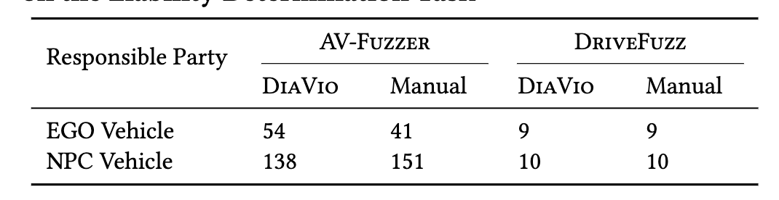
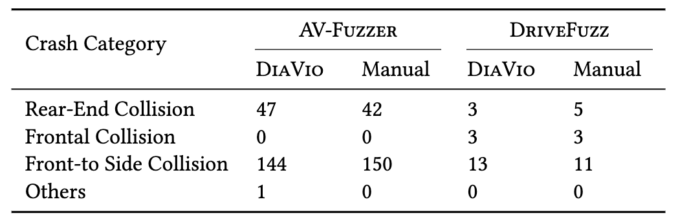
Effectiveness and Efficiency of DiaVio in Diagnosing Violation Scenarios (RQ3)
Results of DiaVio Compared with Manual Diagnosis on the Liability Determination Task
Results of DiaVio Compared with Manual Diagnosis on the Crash Classification Task
ResponsibleParty: V1.
ReasonForLiability: The causation is that V1 failed to yield the right of way to V2, which had the green light, and instead turned left into the path of V2. This action caused the front of V2 to collide with the left side of V1 even though V1 had decelerated to avoid collision. It's also worth mentioning that the road conditions were wet due to rain, which may have contributed to the severity of the impact.
CrashCategory: Front-to-Side.
ReasonForCategory: The description of the crash states that V2 was traveling north on the 2-lane road and struck V1 in the left side as it was trying to change lane to the left. This indicates that the front of V2 collided with the side of V1, which fits the definition of a Front-to-Side Collision.
Example diagnosis of Fine-Tuned Llama2-70b-chat-hf
Example diagnosis of Fine-Tuned Llama2-70b-chat-hf
DiaVio achieves an accuracy of 93.84% and 96.21% on liability determination and crash classification efficiently
DiaVio can eliminate a large number of violation scenarios caused by NPC vehicles, significantly improving the efficiency of violation diagnosis
Notes:
We ran AV-fuzzer and Drivefuzz respectively, and used our tools to diagnose and compare the results with manual analysis.
The results show that:
our tool achieves an accuracy of 93.84% and 96.21% on liability determination and crash classification efficiently
it can eliminate a large number of violation scenarios caused by NPC vehicles, significantly improving the efficiency of violation diagnosis

Slide 16
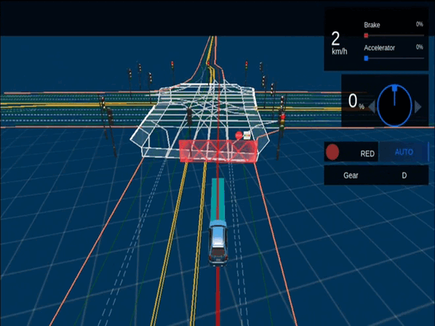
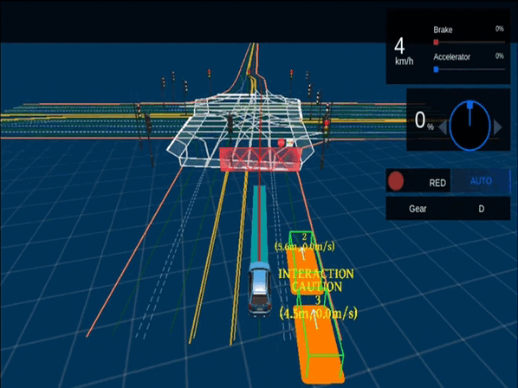
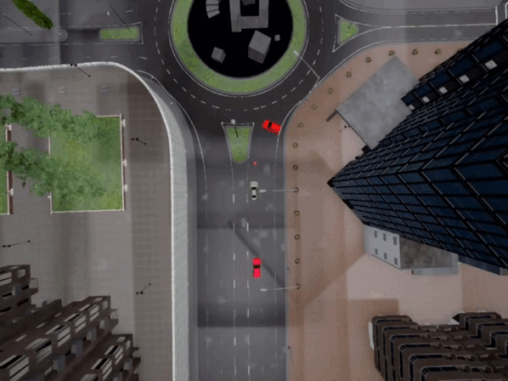
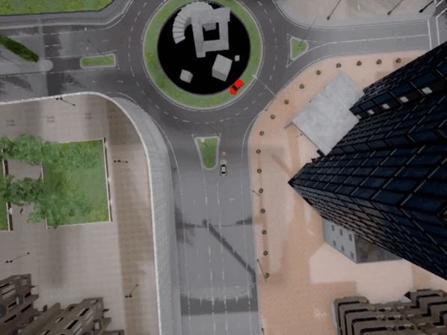
Types of Violations Found by DiaVio (RQ4)
Violation Examples Found by DiaVio
Caused by Ego (AV-Fuzzer)
Caused by NPC (AV-Fuzzer)
Caused by Ego (DriveFuzz)
Caused by NPC (DriveFuzz)
Notes:
Here we show some diagnostic results. These violation scenarios are caused by ADS and NPC respectively.

Slide 17
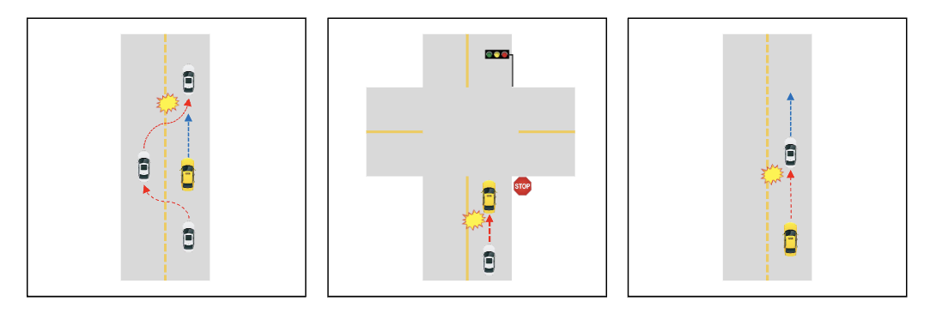
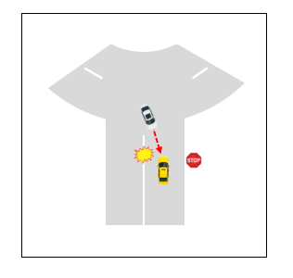
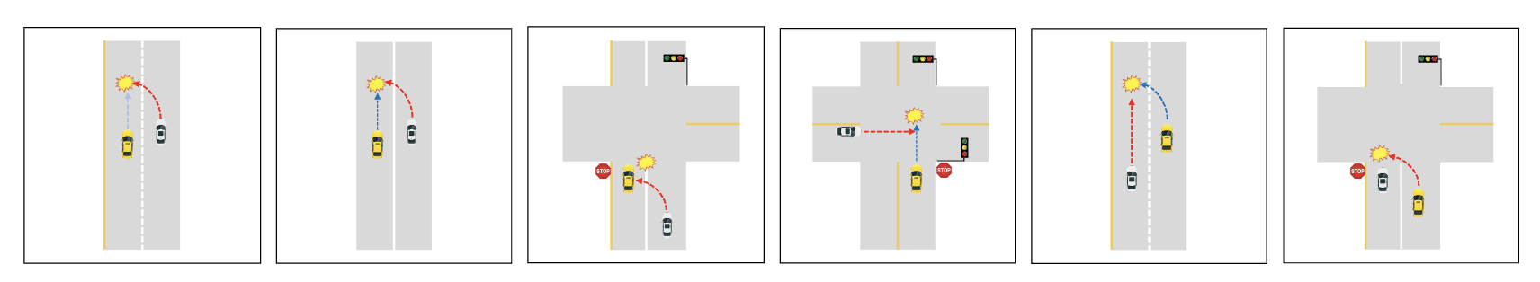
Types of Violations Found by DiaVio (RQ4)
Rear-End Crashes
Frontal Crashes
Front-to-Side Crashes
Liability determination helps eliminate violations caused by NPC vehicles, and crash classification helps quickly summarize common types without the need to look into each violation of the same crash category
Notes:
Our fine-tuned LLM have classfied the violation scenarios into 3 categaries. Rear-End Crashes, Frontal Crashes and Front-to-Side Crashes. All kinds of the violation scenarios caused by the NPC vehicle and EGO vehicle are shown in our paper and website.
In conclusion, Liability determination ability of our tool helps eliminate violations caused by NPC vehicles, and crash classification ability of our tool helps quickly summarize common types without the need to look into each violation of the same crash category

Slide 18
Q & A
You Lu, Yifan Tian, Yuyang Bi, Bihuan Chen, Xin Peng
Fudan University, Shanghai, China
luy22@m.fudan.edu.cn
Notes:
Thatis all for my sharing. Thank you all guys for listening.
We have interview some developers and tester in the industry. We consider that:
Our tool can eliminate a large number of violation scenarios caused by NPC vehicles, significantly improving the efficiency of violation diagnosis. Although DiaVio may not provide perfect reasons and even sometimes lead to a wrong direction, we still think these reasons and output of the large language model can serve a guiding role.

Slide 19
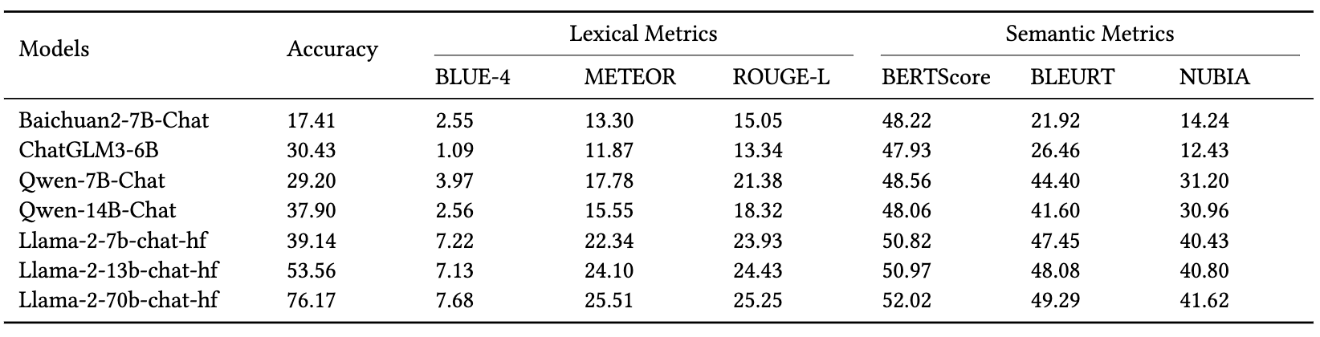
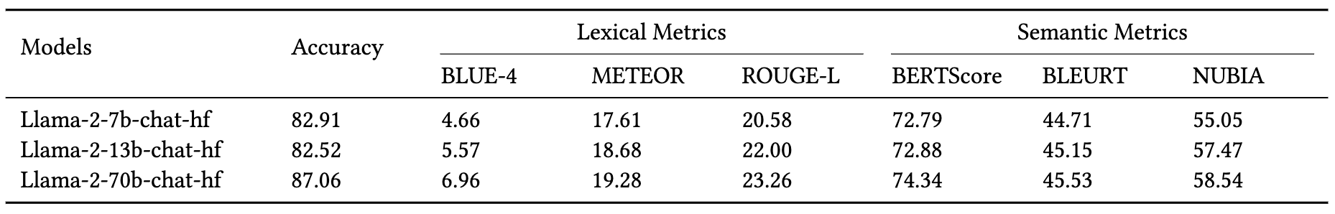
Effectiveness on the Liability Determination Task (RQ1)
Results of Base LLMs
Results of Fine-Tuned LLMs
Fine-tuning enables base LLMs to gain a better capability of liability determination by not only accurately determining the responsible party but also explaining the reason
Fine-tuned Llama2-70b-chat-hf performs the best, and is effective in the liability determination task

Slide 20
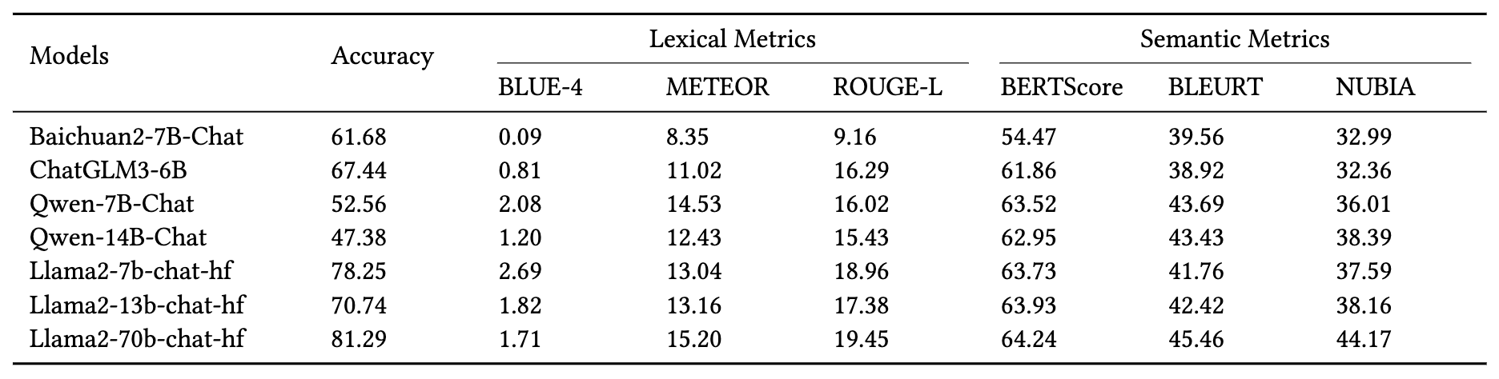
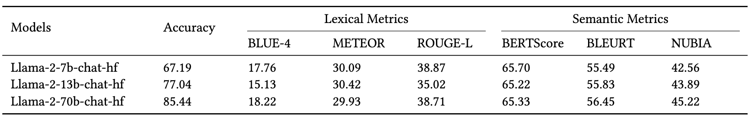
Effectiveness on the Crash Classification Task (RQ2)
Results of Base LLMs
Results of Fine-Tuned LLMs
Fine-tuning enables base LLMs to have a deeper understanding of crash classification by not only accurately classifying the crash category but also explaining the reason.
Llama2-70b-chat-hf performs the best, and is effective in the crash classification task.
Notes:
Similarly, fine-tunning enables base LLMs to have a deeper understanding of crash classification by not only accurately classifying the crash category but also explaining the reason.
Llama2-70b-chat-hf performs the best, and is effective in the crash classification task.

Slide 21
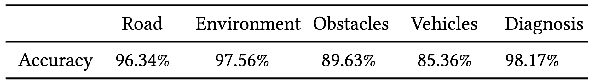
Quality of Accident Report Parsing (RQ5)
Due to the large number of accident reports, we evaluate the quality of GPT-4’s parsing through a sampling approach. We randomly select 369 accident reports from a total of 9,365 accident reports, achieving a confidence level of 95% and a margin error of 5%.
Quality of GPT-4’s Accident Report Parsing
GPT-4 accurately parse the crash information from traffic accident reports, which helps to enhance the performance of base LLMs on our diagnosis task through fine-tuning
Notes:
Finally, to evaluate the quality of the dataset, we conduct manual evaluation on the data converted by GPT4 parsing. We find that GPT-4 accurately parse the crash information from traffic accident reports, which helps to enhance the performance of base LLMs on our diagnosis task through fine-tuning
In RQ5, we adopt a sampling approach to evaluate the quality of GPT-4’s parsing capability for the entire set of 9,365 accident reports. The sample size of 369 reports means to achieve a statistical confidence level of 95% with a margin of error of 5%. We manually check the subcomponents in each report. If the information extraction of a subcomponent is wrong or missing, we consider the information extraction of this component to be inaccurate. We will provide the detailed accuracy of subcomponent in the final version.

Slide 22
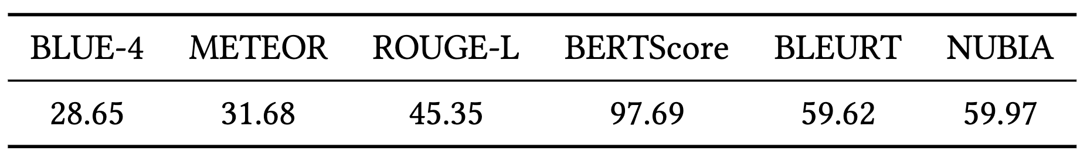
Consistency of Our LLM-Empowered Violation Diagnosis (RQ5)
Lexical and Semantic Comparison of the Reasons Generated by Fine-Tuned Llama2-70b-chat-hf
DiaVio, empowered by LLM, can produce consistent diagnostic results
Notes:
We let the fine-tuned model perform multiple diagnosis on the same collision scenario and we compared the similarity of the model output from the lexical and semantic dimensions. In the end, our tool can provide consistent diagnostic results.
In conclusion, our tool can eliminate a large number of violation scenarios caused by NPC vehicles, significantly improving the efficiency of violation diagnosis. Although DiaVio may not provide perfect reasons and even sometimes lead to a wrong direction, we still think these reasons can help us quickly diagnose violations, serving a guiding role.

